Slide 1
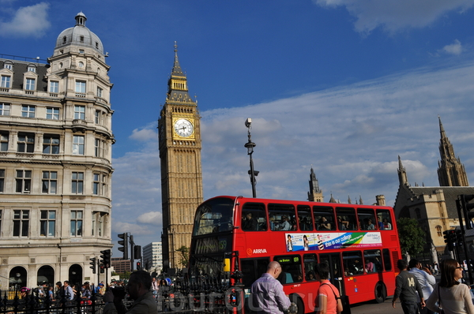
The most popular souvenirs which you can buy in the UK.

Slide 2
UK has 5 regions

Slide 3
every region has original souvenirs and tourists buy them for memory
Lets have a look into the pockets!

Slide 4
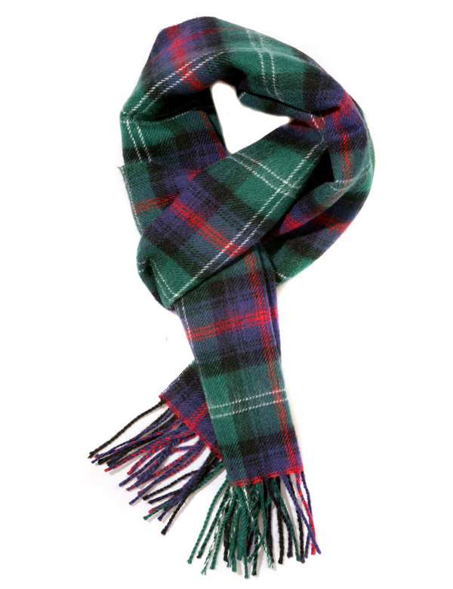
This is tartan scarf from Scotland!
Tartan cloth is very popular in Scotland

Slide 5
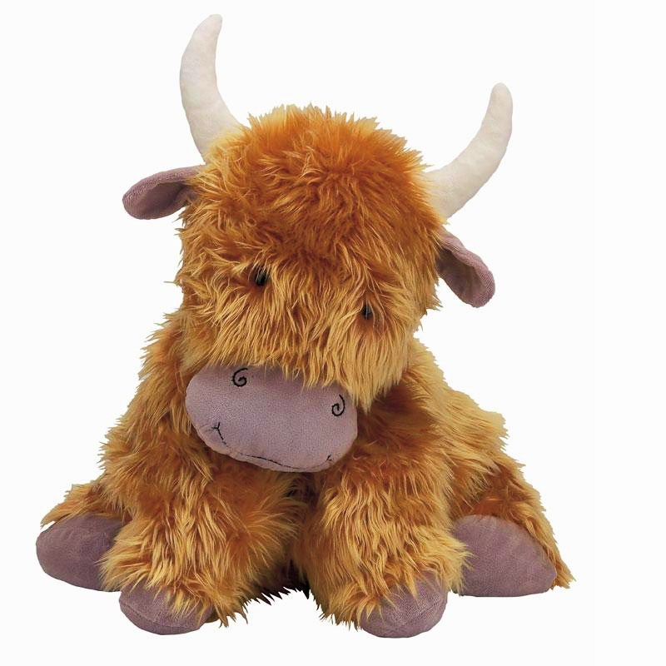
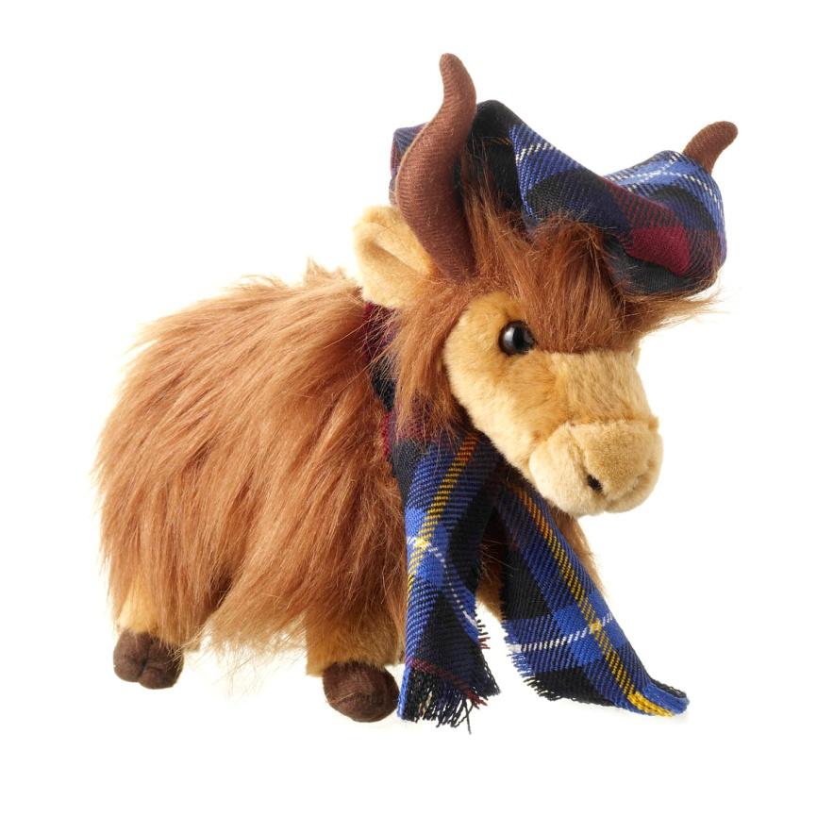
This is a stuffed toy. It looks like a cow. There are many cows in Scotland

Slide 6
This is a hat. It has got shamrocks on it. The shamrock is the national symbol of Ireland

Slide 7
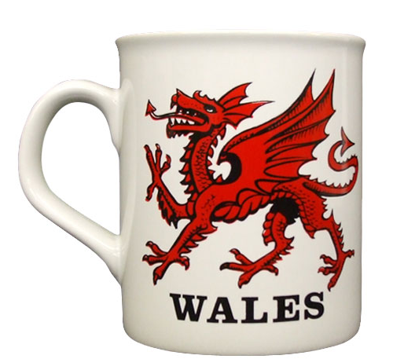
This is a mug. It has got a Welsh dragon on it. The Welsh dragon is on the flag of Wales.

Slide 8
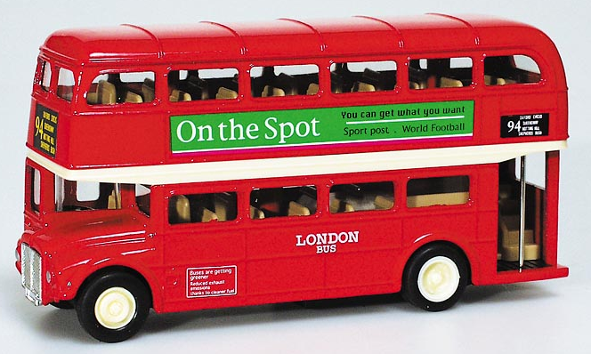
These are toy buses. They are double-decker buses.
You can see these in London

Slide 9
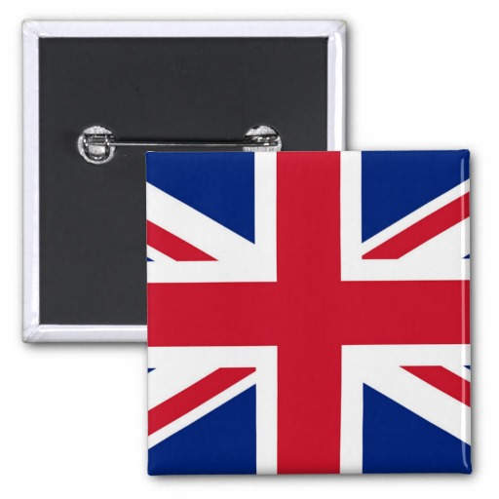
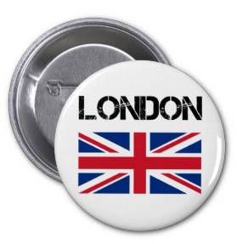
This is a pin. It has got a Union Jack on it. The Union Jack is the flag of the UK

Slide 10
These were 5 the most popular souvenirs in UK.
Which of them do you like?
Which do you want to buy for mum, for your friend and for you teacher?

Slide 11
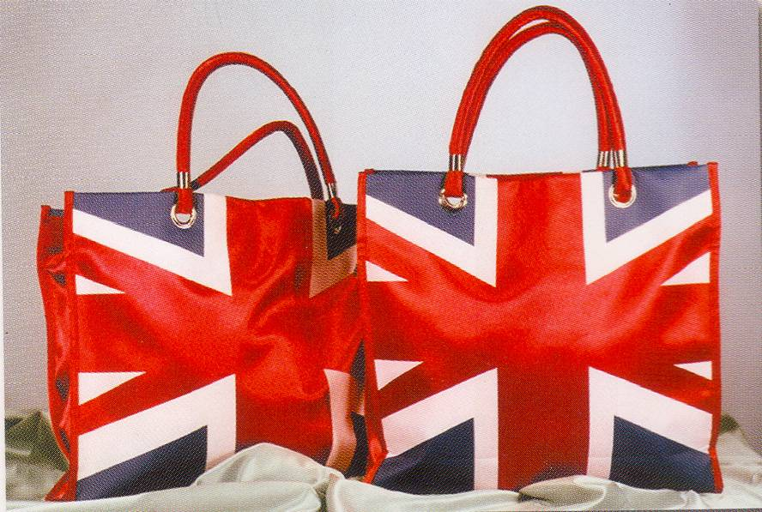
Thank you for attention!

